Slide 1
Design & the Internet Pt 2.

Slide 2
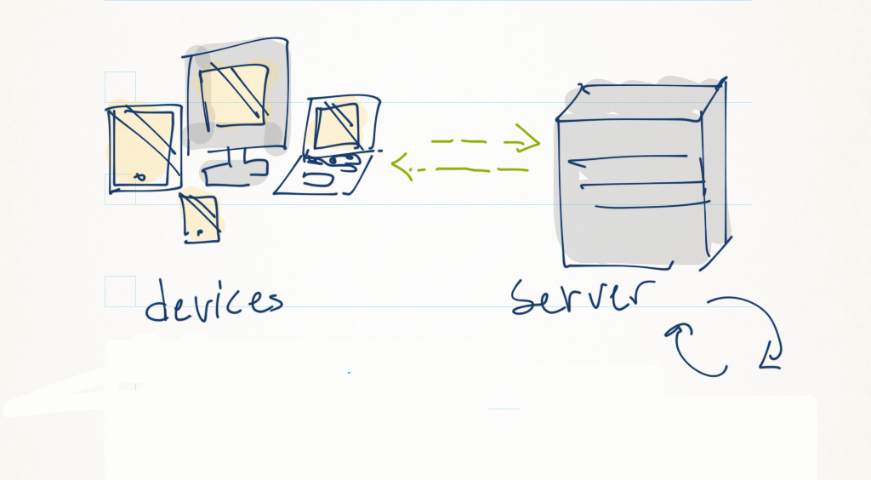
Different languages & tools for different sides of the network

Slide 3
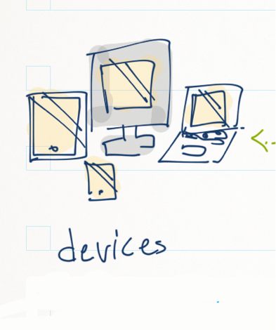
Stuff that runs on your devices is CLIENT-SIDE
Browsers use:
HTML/CSS
Javascript
Plugins (Flash, Java)
Native apps use the platform they’re built on:
IOS
Mac OS
Windows
Android

Slide 4
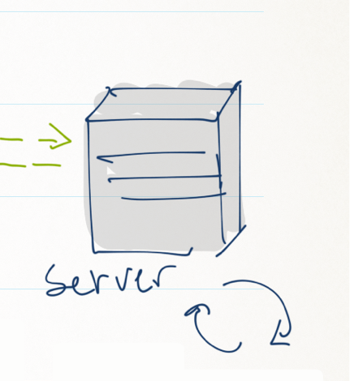
Stuff that runs on the server (or cloud) is SERVER-SIDE
PHP
MySQL
Ruby on Rails

Slide 5
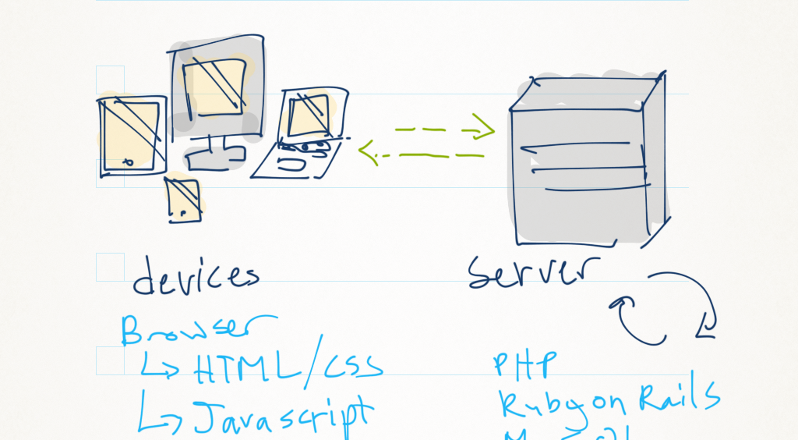
Presentation & quick interaction
Content, Data analysis and storage

Slide 6
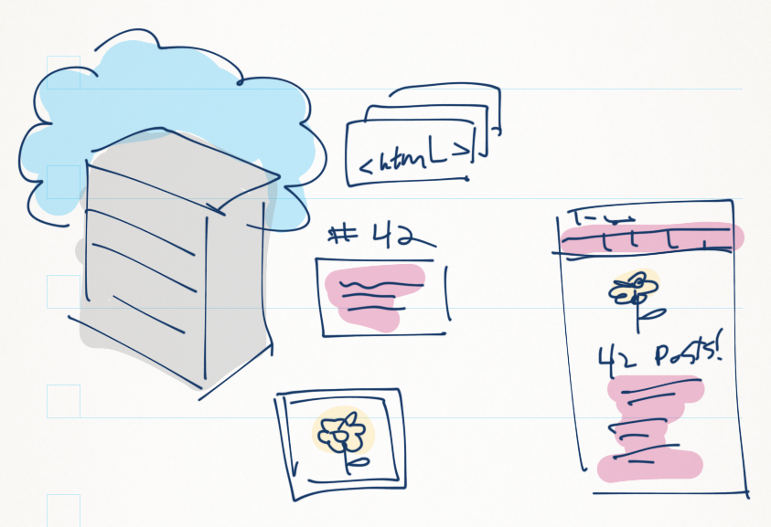
CMS – Content Management System
A CMS is a system that manages your content. This includes adding, editing, displaying and hiding info. CMS’s also manage the user accounts that content is associated with.
Notes:
The beauty of a CMS:
You don’t have to create every page by hand
You often only have ~6 pages that can appear to be hundreds
Pages change based on what the user is looking for.

Slide 7
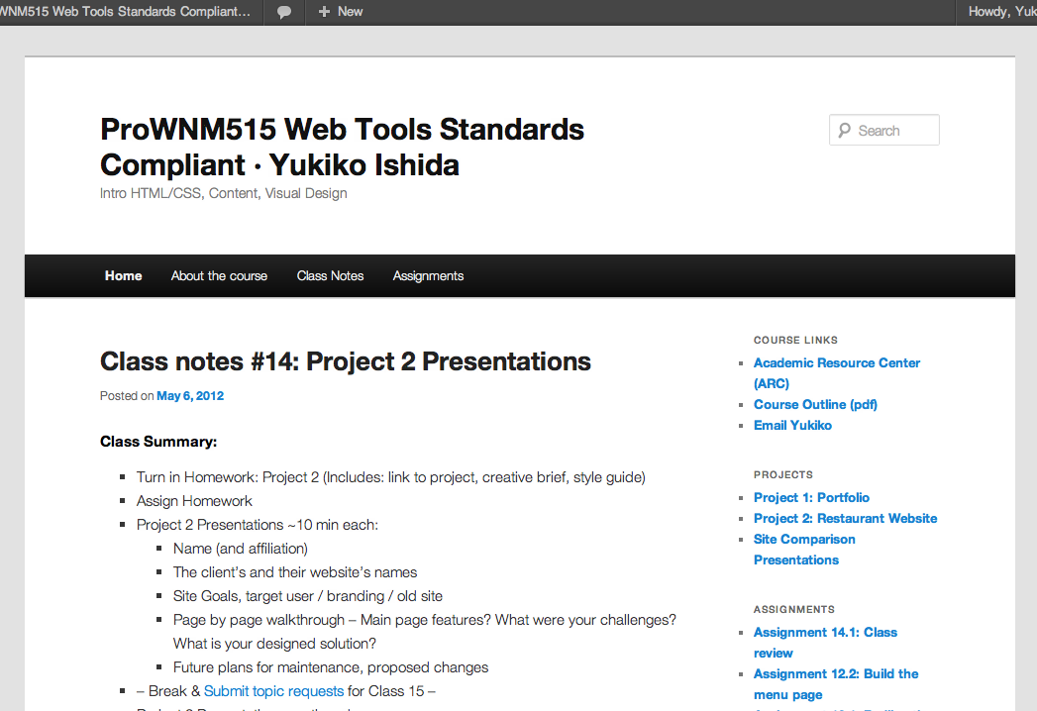

Slide 8

Wordpress
Uses PHP with a MySQL Database to serve up custom content
Freeform CMS
You decide how to display content
You create the look and the feel
You can add content, form, and functionality
Lots of plugins & themes
You host it (install it on your hosting server)

Slide 9
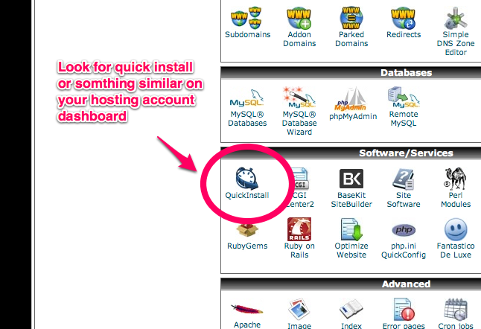

Slide 10
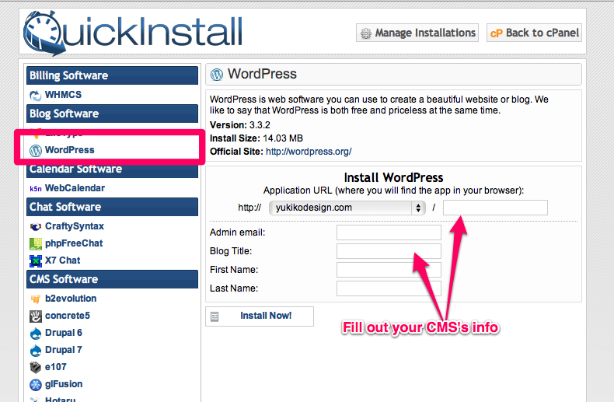

Slide 11
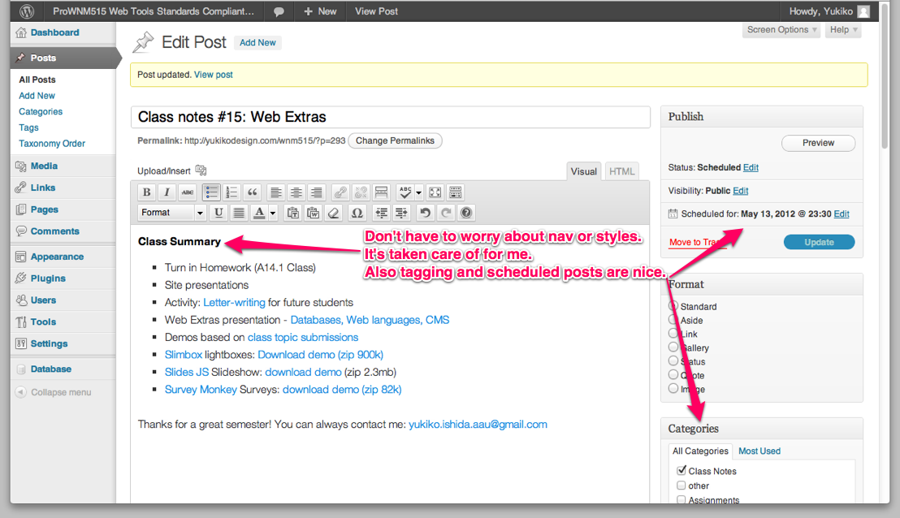

Slide 12
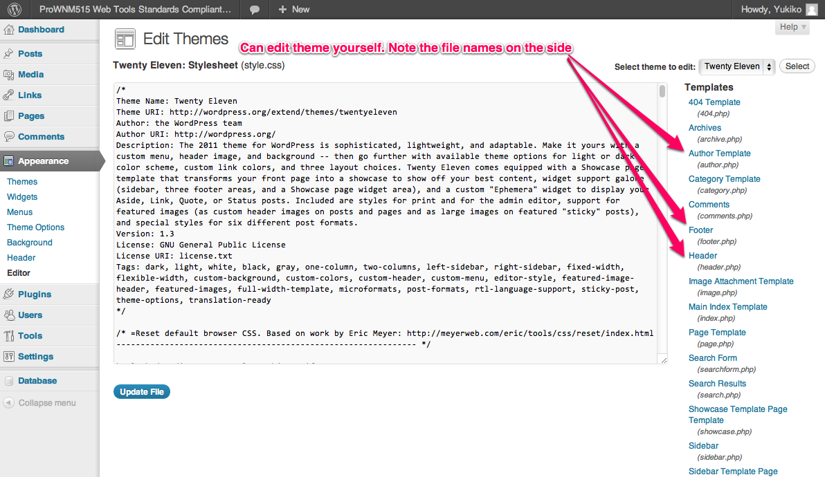

Slide 13
Presentation & quick interaction
Content, Data analysis and storage

Slide 14


Notes:
One of the more difficult subjects for me to talk about is mobile design. It’s a very hot area for designers, but its still pretty new. Everyone’s doing things differently so there’s a plethora of tools and techniques that may or may not suit the job at hand. One of the first things to think about is that mobile is not isolated. There’s a plethora of devices that we interact.

Slide 15

Link the .js file within your HTML file
Select items using CSS selectors
Then give an action
$(.article).fadeIn();
$(#logo).slideUp();
jQuery takes a lot of the work out of Javascript

Slide 16
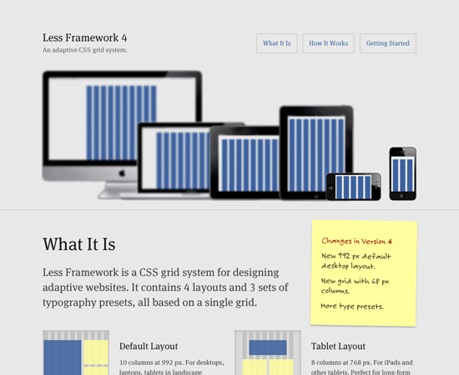
Not just mobile
One of the more difficult subjects for me to talk about is mobile design. It’s a very hot area for designers, but its still pretty new. Everyone’s doing things differently so there’s a plethora of tools and techniques that may or may not suit the job at hand. One of the first things to think about is that mobile is not isolated. Device size and capability is becoming more varied and nuanced by the week.

Slide 17
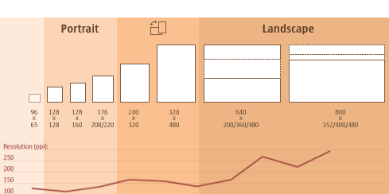
2 Major challenges
Figure out what type of device?
Adjust type of content
Determine size of screen?
Adjust layout and presentation
http://sender11.typepad.com/sender11/2008/04/mobile-screen-s.html
mbricks

Slide 18
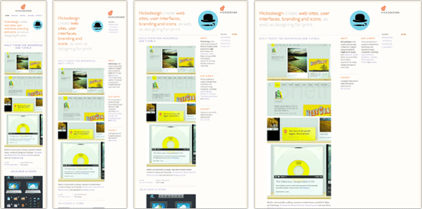
Think about fluid, adaptive layouts
http://mobile.smashingmagazine.com/2011/07/11/picking-a-mobile-support-strategy-for-your-website/#more-97261
Hicks design

Slide 19
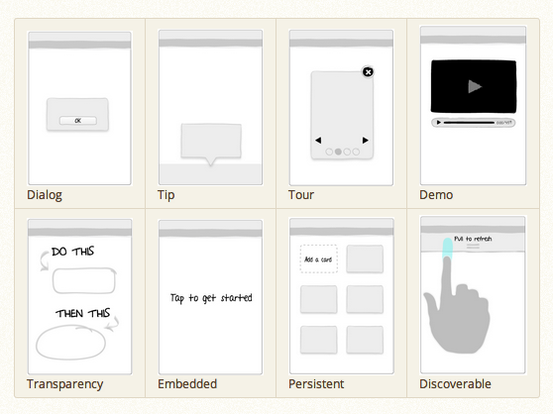
Research touchscreen interaction patterns

Slide 20
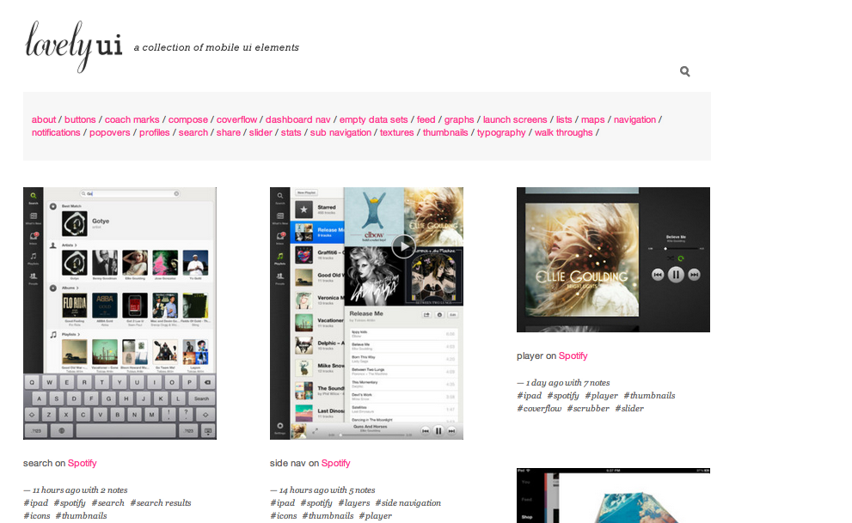
Look at what’s out there now
Notes:
http://www.lovelyui.com/

Slide 21
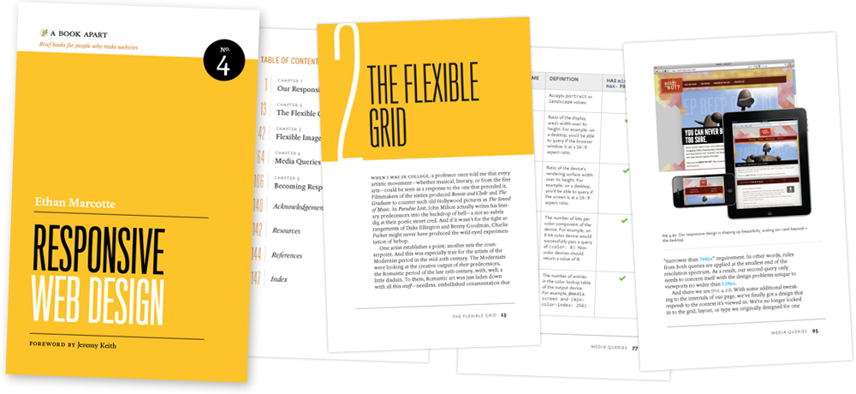
More Reading
http://www.alistapart.com/articles/responsive-web-design/
http://mobile.smashingmagazine.com/2011/07/22/responsive-web-design-techniques-tools-and-design-strategies/
http://blog.cloudfour.com/css-media-query-for-mobile-is-fools-gold/

